Slide 1
Chapter Five
SDLC and Software Development Model Approaches: Use-case-oriented modeling

Slide 2
Introduction
Software development life cycle (SDLC) is a series of phases that provide a common understanding of the software building process.
The good software engineer should have enough knowledge on how to choose the SDLC model based on the project context and the business requirements.
Therefore, it may be required to choose the right SDLC model according to the specific concerns and requirements of the project to ensure its success.

Slide 3
Types of Software developing Model Approaches
Waterfall model
V-Model
Incremental Model
Agile Model
Iterative Model and many more.

Slide 4
Waterfall model
This model has five phases:
Requirements analysis and specification
design,
implementation, and unit testing,
integration and system testing, and
operation and maintenance.
The steps always follow in this order and do not overlap.
The developer must complete every phase before the next phase begins.
This model is named "Waterfall Model", because its diagrammatic representation resembles a cascade of waterfalls.

Slide 5
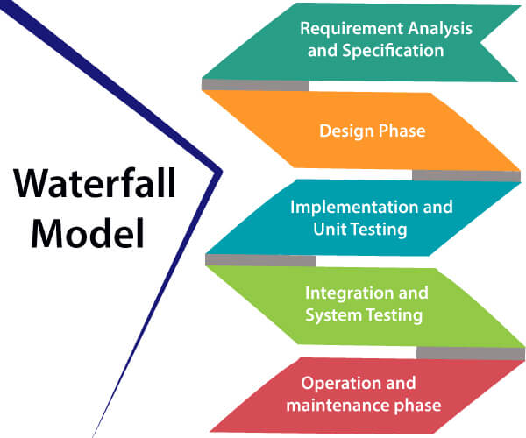
Cont’d…

Slide 6
Cont’d…
Requirements analysis and specification phase:
The aim of this phase is to understand the exact requirements of the customer and to document them properly.
In this phase, a large document called SRS document is created which contained a detailed description of what the system will do in the common language.
B. Design Phase:
This phase aims to transform the requirements gathered in the SRS into a suitable form which permits further coding in a programming language.
It defines the overall software architecture together with high level and detailed design.
All this work is documented as a Software Design Document (SDD).

Slide 7
Cont’d…
C. Implementation and unit testing:
During this phase, design is implemented.
If the SDD is complete, the implementation or coding phase proceeds smoothly, because all the information needed by software developers is contained in the SDD.
During testing, the code is thoroughly examined and modified.
Small modules are tested in isolation initially.
After that these modules are tested by writing some code to check the interaction between these modules and the flow of intermediate output.

Slide 8
Cont’d…
D. Integration and System Testing:
This phase is highly crucial as the quality of the end product is determined by the effectiveness of the testing carried out.
The better output will lead to satisfied customers, lower maintenance costs, and accurate results.
In this phase, the modules are tested for their interactions with each other and with the system.
E. Operation and maintenance phase
Maintenance is the task performed once the software has been delivered to the customer, installed, and operational.

Slide 9
Cont’d…
When to use SDLC Waterfall Model?
Some Circumstances where the use of the Waterfall model is most suited are:
When the requirements are constant and not changed regularly.
A project is short
The situation is calm
Where the tools and technology used is consistent and is not changing
When resources are well prepared and are available to use.

Slide 10
Cont’d…
Advantages of Waterfall model
This model is simple to implement also the number of resources that are required for it is minimal.
The requirements are simple and explicitly declared; they remain unchanged during the entire project development.
The start and end points for each phase is fixed, which makes it easy to cover progress.
The release date for the complete product, as well as its final cost, can be determined before development.
It gives easy to control and clarity for the customer due to a strict reporting system.

Slide 11
Cont’d…
Disadvantages of Waterfall model
In this model, the risk factor is higher, so this model is not suitable for more significant and complex projects.
This model cannot accept the changes in requirements during development.
It becomes tough to go back to the phase.
For example, if the application has now shifted to the coding phase, and there is a change in requirement, It becomes tough to go back and change it.
Since the testing done at a later stage, it does not allow identifying the challenges and risks in the earlier phase, so the risk reduction strategy is difficult to prepare.

Slide 12
V-Model
It is also referred to as the Verification and Validation Model.
Each phase of SDLC must complete before the next phase starts.
It follows a sequential design process same as the waterfall model.
Testing is planned in parallel with a corresponding stage of development.

Slide 13
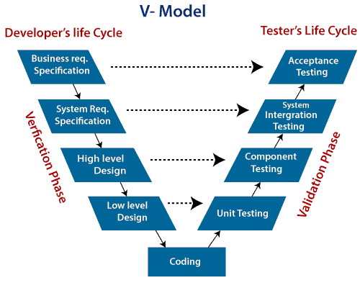
Cont’d…

Slide 14
Cont’d…
Verification:
It involves a static analysis method (review) done without executing code.
It is the process of evaluation of the product development process to find whether specified requirements meet.
Validation:
It involves dynamic analysis method (functional, non-functional), testing is done by executing code.
Validation is the process to classify the software after the completion of the development process to determine whether the software meets the customer expectations and requirements.
Verification and Validation process is joined by coding phase in V-shape.
Thus it is known as V-Model.

Slide 15
Cont’d…
There are the various phases of Verification Phase of V-model:
Business requirement analysis:
This is the first step where product requirements understood from the customer's side.
It contains detailed communication to understand customer's expectations and exact requirements.
B. System Design:
In this stage system engineers analyze and interpret the business of the proposed system by studying the user requirements document.
C. Architecture Design:
The baseline in selecting the architecture is that it should understand all which typically consists of the list of modules, brief functionality of each module, their interface relationships, dependencies, database tables, architecture diagrams, technology detail, etc.
The integration testing model is carried out in a particular phase.

Slide 16
Cont’d…
D. Module Design:
the system breaks down into small modules.
The detailed design of the modules is specified, which is known as Low-Level Design
E. Coding Phase:
After designing, the coding phase is started.
Based on the requirements, a suitable programming language is decided.
There are some guidelines and standards for coding.
Before checking in the repository, the final build is optimized for better performance, and the code goes through many code reviews to check the performance.

Slide 17
Cont’d…
There are the various phases of Validation Phase of V-model:
Unit Testing:
Unit Test Plans (UTPs) are developed during the module design phase.
These UTPs are executed to eliminate errors at code level or unit level.
A unit is the smallest entity which can independently exist, e.g., a program module.
Unit testing verifies that the smallest entity can function correctly when isolated from the rest of the codes/ units.
B. Integration Testing:
Integration Test Plans are developed during the Architectural Design Phase.
These tests verify that groups created and tested independently can coexist and communicate among themselves.

Slide 18
Cont’d…
C. System Testing:
System Tests Plans are developed during System Design Phase.
Unlike Unit and Integration Test Plans, System Tests Plans are composed by the clients business team.
System Test ensures that expectations from an application developer are met.
D. Acceptance Testing:
Acceptance testing is related to the business requirement analysis part.
It includes testing the software product in user atmosphere.
Acceptance tests reveal the compatibility problems with the different systems, which is available within the user atmosphere.

Slide 19
Cont’d…
When to use V-Model?
When the requirement is well defined and not ambiguous.
The V-shaped model should be used for small to medium-sized projects where requirements are clearly defined and fixed.
The V-shaped model should be chosen when sample technical resources are available with essential technical expertise.
Advantage of V-Model:
Easy to Understand.
Testing Methods like planning, test designing happens well before coding.
This saves a lot of time. Hence a higher chance of success over the waterfall model.
Avoids the downward flow of the defects.
Works well for small plans where requirements are easily understood.

Slide 20
Cont’d…
Disadvantage of V-Model:
Very rigid and least flexible.
Not a good for a complex project.
Software is developed during the implementation stage, so no early prototypes of the software are produced.
If any changes happen in the midway, then the test documents along with the required documents, has to be updated.

Slide 21
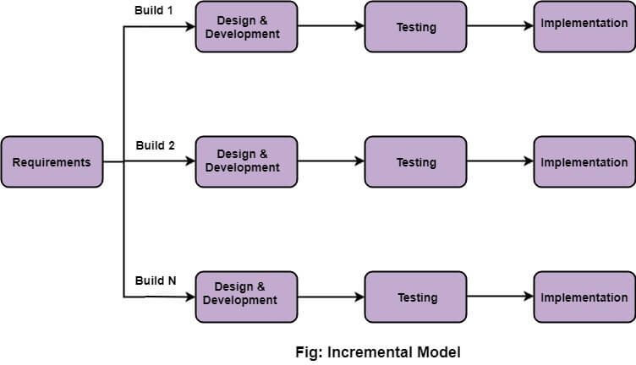
Incremental Model
It is a process of software development where requirements divided into multiple standalone modules of the software development cycle.
Each module goes through the requirements, design, implementation and testing phases.
Every subsequent release of the module adds function to the previous release.
The process continues until the complete system achieved.

Slide 22
Cont’d…
The various phases of incremental model are as follows:
1. Requirement analysis:
In the first phase of the incremental model, the product analysis expertise identifies the requirements.
And the system functional requirements are understood by the requirement analysis team.
To develop the software under the incremental model, this phase performs a crucial role.
2. Design & Development:
In this phase of the Incremental model of SDLC, the design of the system functionality and the development method are finished with success.

Slide 23
Cont’d…
3. Testing:
the testing phase checks the performance of each existing function as well as additional functionality.
the various methods are used to test the behavior of each task.
4. Implementation:
Implementation phase enables the coding phase of the development system.
It involves the final coding.
After completion of this phase, the number of the product working is enhanced and upgraded up to the final system product

Slide 24
Cont’d…
When we use the Incremental Model?
When the requirements are more.
A project has a lengthy development schedule.
When Software team are not very well skilled or trained.
When the customer demands a quick release of the product.
You can develop prioritized requirements first.
Advantage of Incremental Model
Errors are easy to be recognized.
Easier to test and debug
More flexible.
Simple to manage risk because it handled during its iteration.
The Client gets important functionality early.

Slide 25
Cont’d…
Disadvantage of Incremental Model
Need for good planning
Total Cost is high.
Well defined module interfaces are needed.

Slide 26
Agile Model
The meaning of Agile is swift or versatile.“
Agile process model" refers to a software development approach based on iterative development.
Agile methods break tasks into smaller iterations, or parts do not directly involve long term planning.
The project scope and requirements are laid down at the beginning of the development process.
Plans regarding the number of iterations, the duration and the scope of each iteration are clearly defined in advance.

Slide 27
Cont’d…
Each iteration is considered as a short time "frame" in the Agile process model, which typically lasts from one to four weeks.
The division of the entire project into smaller parts helps to minimize the project risk and to reduce the overall project delivery time requirements.
Each iteration involves a team working through a full software development life cycle including planning, requirements analysis, design, coding, and testing before a working product is demonstrated to the client.

Slide 28
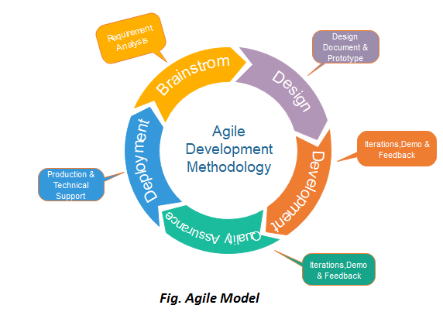
Cont’d…

Slide 29
Cont’d…
Phases of Agile Model
Requirements gathering:
In this phase, you must define the requirements.
You should explain business opportunities and plan the time and effort needed to build the project.
Based on this information, you can evaluate technical and economic feasibility.
2. Design the requirements: When you have identified the project, work with stakeholders to define requirements.
You can use the user flow diagram or the high-level UML diagram to show the work of new features and show how it will apply to your existing system.

Slide 30
Cont’d…
3. Construction/ iteration: When the team defines the requirements, the work begins.
Designers and developers start working on their project, which aims to deploy a working product.
The product will undergo various stages of improvement, so it includes simple, minimal functionality.
4. Testing: In this phase, the Quality Assurance team examines the product's performance and looks for the bug.
5. Deployment: In this phase, the team issues a product for the user's work environment.
6. Feedback: After releasing the product, the last step is feedback.
In this, the team receives feedback about the product and works through the feedback.

Slide 31
Cont’d…
When to use the Agile Model?
When frequent changes are required.
When a highly qualified and experienced team is available.
When a customer is ready to have a meeting with a software team all the time.
When project size is small.
Advantage(Pros) of Agile Method:
Frequent Delivery
Face-to-Face Communication with clients.
Efficient design and fulfils the business requirement.
Anytime changes are acceptable.
It reduces total development time.

Slide 32
Cont’d…
Disadvantages(Cons) of Agile Model:
Due to the shortage of formal documents, it creates confusion and crucial decisions taken throughout various phases can be misinterpreted at any time by different team members.
Due to the lack of proper documentation, once the project completes and the developers allotted to another project, maintenance of the finished project can become a difficulty.

Slide 33
Iterative Model
In this Model, you can start with some of the software specifications and develop the first version of the software.
After the first version if there is a need to change the software, then a new version of the software is created with a new iteration.
Every release of the Iterative Model finishes in an exact and fixed period that is called iteration.
The Iterative Model allows the accessing of earlier phases, in which the variations made respectively.
The final output of the project renewed at the end of the Software Development Life Cycle (SDLC) process.

Slide 34
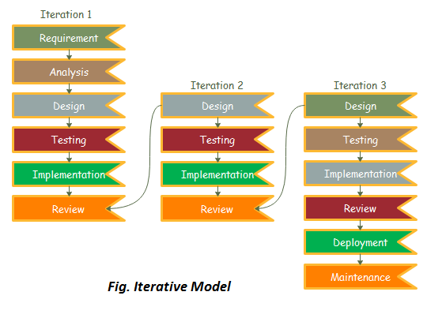
Cont’d…

Slide 35
Cont’d…
The various phases of Iterative model are as follows:
Requirement gathering & analysis:
In this phase, requirements are gathered from customers and check by an analyst whether requirements will fulfil or not.
Analyst checks that need will achieve within budget or not.
After all of this, the software team skips to the next phase.
2. Design:
In the design phase, team design the software by the different diagrams like Data Flow diagram, activity diagram, class diagram, state transition diagram, etc.
3. Implementation:
In the implementation, requirements are written in the coding language and transformed into computer programmes which are called Software.

Slide 36
Cont’d…
4. Testing: After completing the coding phase, software testing starts using different test methods.
5. Deployment: After completing all the phases, software is deployed to its work environment.
6. Review: In this phase, after the product deployment, review phase is performed to check the behaviour and validity of the developed product.
And if there are any error found then the process starts again from the requirement gathering.
7. Maintenance: after deployment of the software in the working environment, there may be some bugs, some errors or new updates are required.
Maintenance involves debugging and new addition options.

Slide 37
Cont’d…
When to use the Iterative Model?
When requirements are defined clearly and easy to understand.
When the software application is large.
When there is a requirement of changes in future.
Advantage of Iterative Model:
Testing and debugging during smaller iteration is easy.
A Parallel development.
It is easily acceptable to ever-changing needs of the project.
Risks are identified and resolved during iteration.
Limited time spent on documentation and extra time on designing.

Slide 38
Cont’d…
Disadvantage of Iterative Model:
It is not suitable for smaller projects.
More Resources may be required.
Design can be changed again and again because of imperfect requirements.
Requirement changes can cause over budget.
Project completion date not confirmed because of changing requirements.

Slide 39
Reading Assignment
RAD Model
Big Bang Model
Prototype Model
Evolutionary Process Model
Agile Testing Methods

Slide 40
Thank You!
?

